Slide 1


DNR/CDB
MACD and MCDEO
Present:
DIY Strategic Planning
2024
Presented by
Terry Profota, MNM
Notes:
1

Slide 2

WE WILL COVER…….
Some strategic planning basics.
Why you would decide to DIY.
Four steps to crafting a DIY Strategic Plan.
Notes:
2

Slide 3

WHAT IS STRATEGIC PLANNING?
Time for discussion
Envisioning the future
Identifying and addressing issues
Building consensus
Notes:
3

Slide 4
WHAT IS A STRATEGIC PLAN:
Road Map for Success
Clear Expectations
Structures for Consistency
Systems for Accountability
Notes:
4

Slide 5

WHY DIY?
Size and scope of your CD
Time commitment
Lack of engagement
Available Funding
Notes:
5

Slide 6

BEFORE YOU GET STARTED?
Who will participate?
How much can be allocated to the process?
Plan time frame? 3-5 years?
When do you want the planning document complete?
Notes:
6

Slide 7
Four Steps to DIY Planning
FRAMEWORK
VISION THE FUTURE
CRAFT YOUR PLAN
GATHER INFO ANALYZE

Slide 8

STEP #1: GATHER INFO & ANALYZE
Notes:
8

Slide 9
STEP #1: GATHER INFO & ANALYZE
Worth the time!
Notes:
9

Slide 10
STEP #1: GATHER INFO & ANALYZE
Ways to gather feedback and get people thinking.
Survey or Questionnaire
DNRC/CDB Strategic Planning Worksheet
Group discussion during a work session
Notes:
10

Slide 11
STEP #1: GATHER INFO & ANALYZE
Continue to do?
Do better?
Stop?
Legal compliance?
Outside influences?
Values?
Identify the Future?
Notes:
11

Slide 12

STEP #2:
ARTICULATE YOUR FRAMEWORK
Notes:
12

Slide 13
STEP #2:
ARTICULATE YOUR FRAMEWORK
WHY/VISION
HOW/MISSION & VALUES
WHAT
Golden Circle: Simon Sinek
Notes:
13

Slide 14
STEP #2: ARTICULATE YOUR WHY
WHAT IS OUR VISION?
Why do we exist?
What do we ultimately want to accomplish?
What will be our long-term impact?
Notes:
14

Slide 15
STEP #2: ARTICULATE YOUR HOW
WHAT IS OUR MISSION?
How do we make our vision a reality?
What will we be doing?
What are our main activities/focus areas?
Notes:
15

Slide 16
STEP #2: ARTICULATE YOUR HOW
WHAT VALUES?
How do we act?
How do we treat each other?
What do we want our community and partners to say about us?
Notes:
16

Slide 17
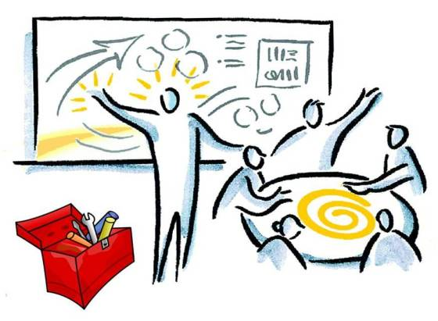
STEP #3: VISION YOUR FUTURE
Notes:
17

Slide 18
STEP #3: VISION YOUR FUTURE
WHY
HOW
WHAT/PRIORITIES & STRATEGIES
Notes:
18

Slide 19
STEP #3: VISION YOUR FUTURE
DEFINE YOUR STRATEGIC VISION BEYOND WHAT CURRENTLY DOING
What expansion will we undertake in our capacity and programming based on the influx of money?
What will we be doing in the next 3-5 years?
Notes:
19

Slide 20
STEP #3: VISION YOUR FUTURE
PRIORITY AREAS TO BUILD CAPACITY
Programming, Education and Outreach
What else?
People
Infrastructure
Partnerships and Community
Public Policy
Notes:
20

Slide 21
STEP #3: VISION YOUR FUTURE
STRATEGIES, DEFINED OUTCOMES.
PEOPLE
Supervisors
Staff
STRUCTURES & SYSTEMS
Financial Management
PROGRAMMING,
EDUCATIONS & OUTREACH
List each initiative and define the strategy/outcome you want to achieve.
Volunteers
Policies and Procedures
Funding
Notes:
21

Slide 22
STEP #3: VISION YOUR FUTURE
STRATEGIES, DEFINED OUTCOMES.
PARTNERSHIPS & COMMUNITY RELATIONS
Government Agencies
Conservation Districts
PUBLIC POLICES
Networking
Nonprofits
The Public
Advocacy
Notes:
22

Slide 23

STEP #4: DOCUMENT THE PLAN
Notes:
23

Slide 24
STEP #4: CRAFT THE PLAN
BRINGING IT ALL TOGETHER
WHY
HOW
WHAT/GOALS
Notes:
24

Slide 25
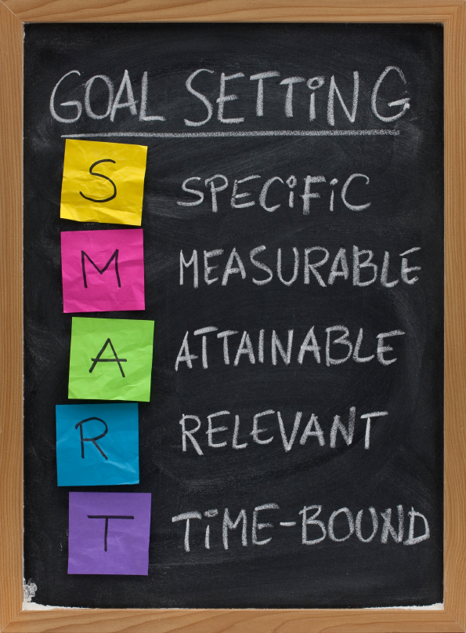
STEP #4: DOCUMENTING THE PLAN
GOALS – ACTION STEPS, THE FOUNDATION FOR ACCOUNTABILITY.
Develop goals for each strategy.
Review annually and update/modify as needed.
Goals move to annual operational plans.
Notes:
25

Slide 26
STEP #4: DOCUMENTING THE PLAN
AN ANNUAL OPERATIONAL WORK PLAN-USE IT OR LOSE IT
Developed by staff.
Delegates responsibilities.
Approved by Supervisors.
Reported on quarterly. Reviewed & approved by Supervisors.
Base for annual performance evaluations.
Notes:
26

Slide 27
JUST TO RECAP. WE COVERED:
Some strategic planning basics.
Why you would decide to DIY.
Four steps to crafting a DIY Strategic Plan.
Notes:
27

Slide 28
A STRATEGIC PLAN IS…………..
Fun and energizing.
A starting point, not an end.
A road map for success.
Clear Expectations
Structures for Consistency
Systems for Accountability
Notes:
28

Slide 29

QUESTIONS?

Slide 30
DNR/CDB
MACD and MCDEO
Present:
DIY Strategic Planning
2024
Presented by
Terry Profota, MNM
Notes:
30

