Slide 1
310 Law Mini Trainings
What is a project?

Slide 2
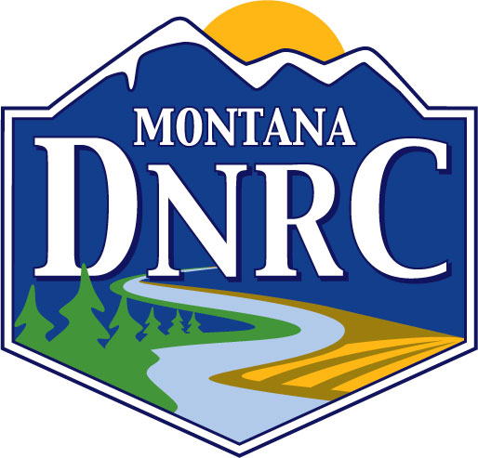
Presentation Home Page
 | Hailey Graf Stream Permitting Coordinator Conservation Districts Bureau Phone : (406) 437-4435 Email: hailey.graf@mt.gov

Slide 3
What we’ll cover today:
Definitions
Montana Code Annotated (MCA)
Administrative Rules of Montana (ARM)
CD Adopted Rules
Pulling it all together
Examples
Q&A

Slide 4
MCA 75-7-103
(5) (a) "Project" means a physical alteration or modification that results in a change in the state of a natural, perennial-flowing stream or river, its bed, or its immediate banks.
Adopted Rules: Physical alteration or modification
Physical alteration or modification means human-caused actions resulting in the placement, removal, or disturbance of materials of any nature or character.

Slide 5
MCA 75-7-103.
(5) (a) "Project" means a physical alteration or modification that results in a change in the state of a natural, perennial-flowing stream or river, its bed, or its immediate banks.
ARM 36.2.402: perennial-flowing stream
means a stream, which in the absence of diversion, impoundment, appropriation, or extreme drought, flows continuously at all seasons of the year and during dry as well as wet years.

Slide 6
MCA 75-7-103..
(5) (a) "Project" means a physical alteration or modification that results in a change in the state of a natural, perennial-flowing stream or river, its bed, or its immediate banks.
ARM 36.2.402: Immediate banks
"Immediate banks" means the area above the mean high water mark and directly adjacent to the stream, which when physically altered or modified has the potential to affect the state of a stream.

Slide 7
Immediate banks
"Immediate banks" means the area above the mean high water mark and directly adjacent to the stream, which when physically altered or modified has the potential to affect the state of a stream.
ARM: Mean high water mark
"Mean high water mark" means the line that water impresses on the land for sufficient periods to cause physical characteristics that distinguish the area below the line from above it. Characteristics of the area below the line include, when appropriate, deprivation of the soil of substantially all terrestrial vegetation and destruction of its agricultural value.

Slide 8
Immediate banks-
"Immediate banks" means the area above the mean high water mark and directly adjacent to the stream, which when physically altered or modified has the potential to affect the state of a stream.

Slide 9
(b) Project does not include:
(i) an activity for which a plan of operation has been submitted to and approved by the district. Any modification to the plan must have prior approval of the district.

Slide 10
(b) Project does not include:
(i) an activity for which a plan of operation has been submitted to and approved by the district. Any modification to the plan must have prior approval of the district.
(ii) customary and historic maintenance and repair of existing irrigation facilities that do not significantly alter or modify the stream in contravention of 75-7-102; or

Slide 11
(b) Project does not include:
(i) an activity for which a plan of operation has been submitted to and approved by the district. Any modification to the plan must have prior approval of the district.
(ii) customary and historic maintenance and repair of existing irrigation facilities that do not significantly alter or modify the stream in contravention of 75-7-102; or
(iii) livestock grazing activities.

Slide 12
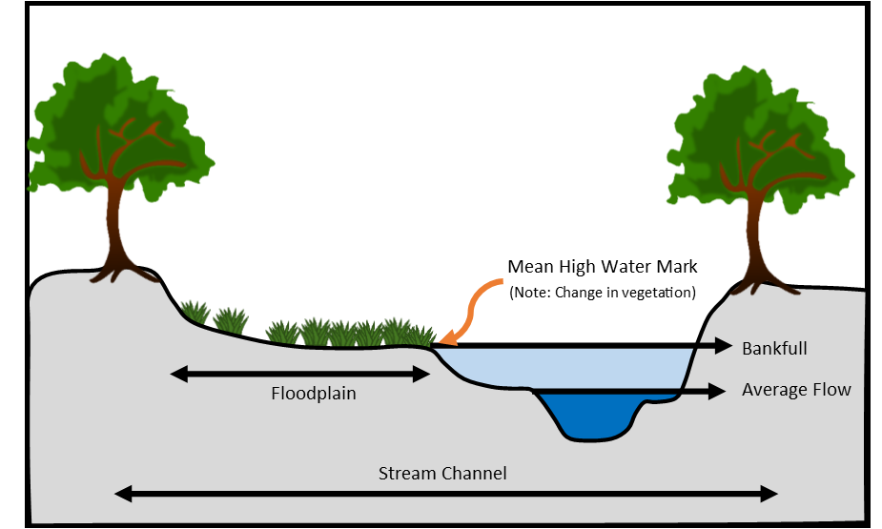
"Project" means a physical alteration or modification that results in a change in the state of a natural, perennial-flowing stream or river, its bed, or its immediate banks.

Slide 13
Is it a project???
Is it human caused?
Does it result in the placement, removal, or disturbance of any material?
Does it have the potential to impact the stream?
Is it a perennial-flowing stream?

Slide 14
Example 1
Pruning trees in riparian area

Slide 15
Example 2
Utility boring

Slide 16
Example 3
Floodgate maintenance
Notes:
customary and historic maintenance and repair of existing irrigation facilities that do not significantly alter or modify the stream

Slide 17
Example 4
Installing a dock in a reservoir

Slide 18
Example 5
Stream restoration

Slide 19
Technical Review
If you are having a difficult time determining if it will impact the stream
If you are having a difficult time determining if it is a perennially-flowing stream

Slide 20
Q&A

